Slide 1
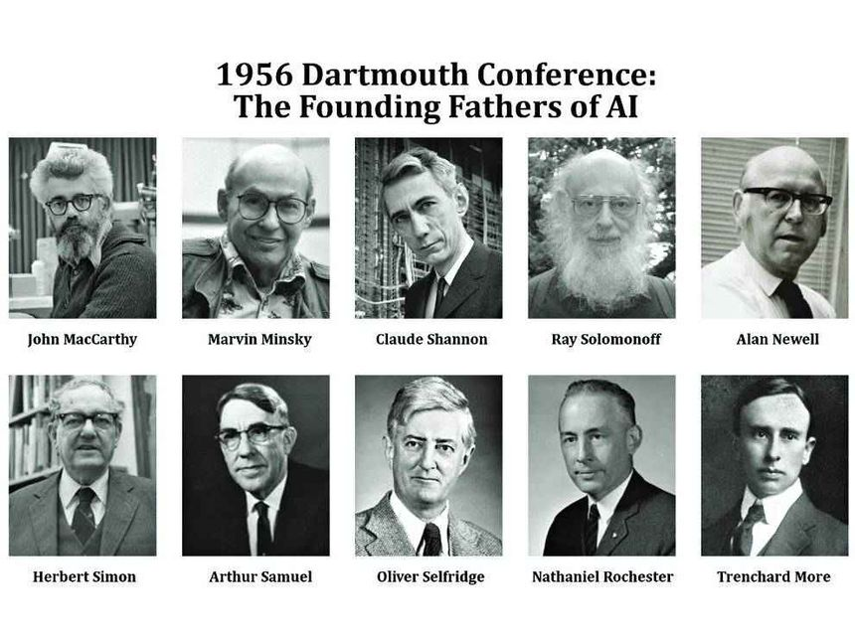
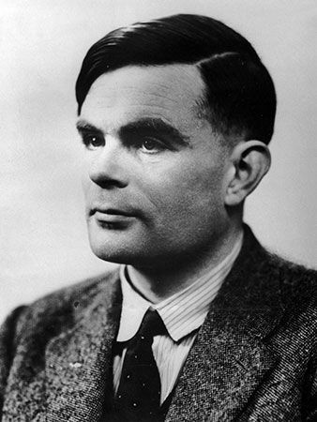
AI Timeline
Birth of AI(1950s)
1950
1956
Turing test
Dartmouth
conference
Turing Test proposed by Alan Turing
Term “Artificial Intelligence” coined by John McCarthy.

Slide 2
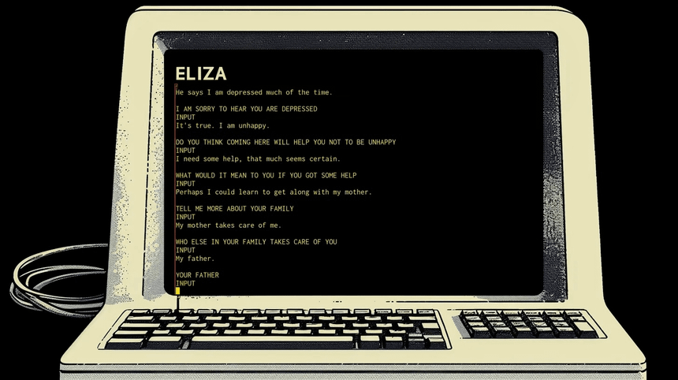
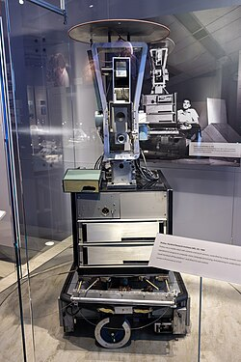
AI Timeline
Early Optimism (1960s)
1966
1969
ELIZA chatbot
Shakey the Robot
Simulated conversation—an early glimpse of NLP.
First robot capable of reasoning about its actions.

Slide 3
AI Timeline
ai WINTER (1970S)
Funding dries up due to high expectations and low performance.

Slide 4
AI Timeline
Expert Systems & Second AI winter (1980s)
1980
1986
1987
1993
XCON Expert System
Backpropagation
Helped configure computers at DEC; AI becomes commercial.
Neural networks learn from errors — a major comeback.
Second AI Winter
Expert systems fail to scale.

Slide 5
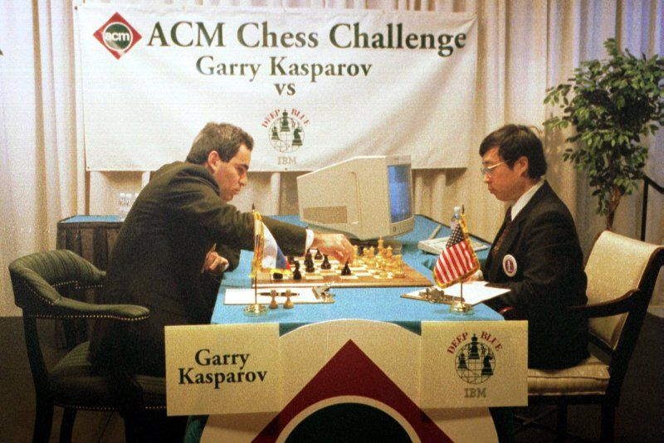
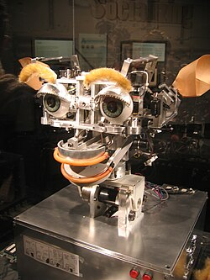
AI Timeline
The Internet and Machine Learning (1990s)
1997
1998
IBM Deep Blue beats Kasparov
Kismet robot
First time a machine defeats a world chess champion.
Introduces emotion-based interactions.

Slide 6
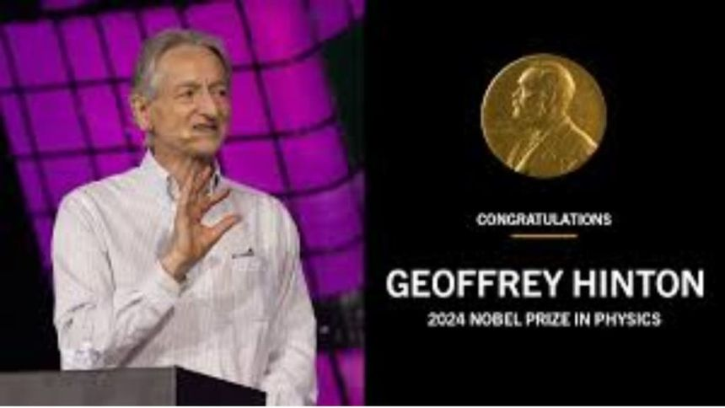
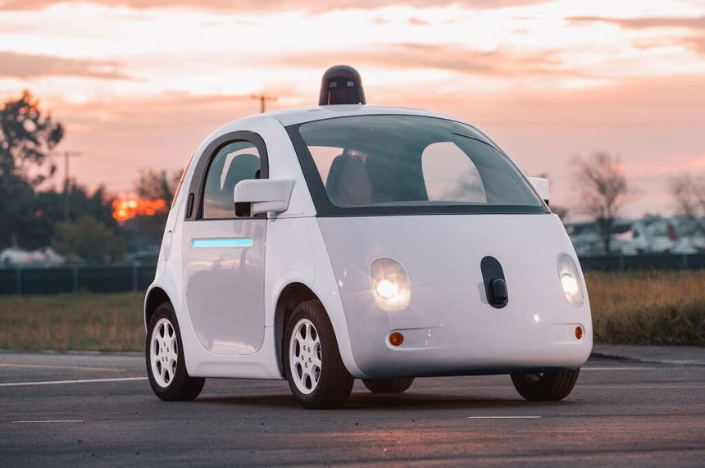
AI Timeline
Data & machine learning (2000s)
2006
2009
Deep learning coined
Google self-driving car
Geoffrey Hinton’s breakthrough on neural networks.
Autonomous systems enter the mainstream.

Slide 7
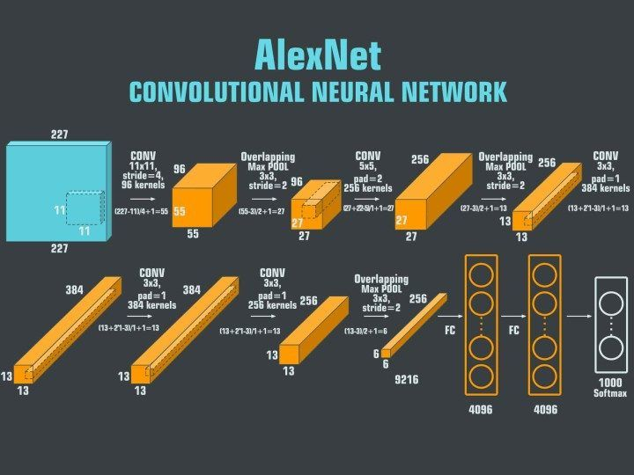
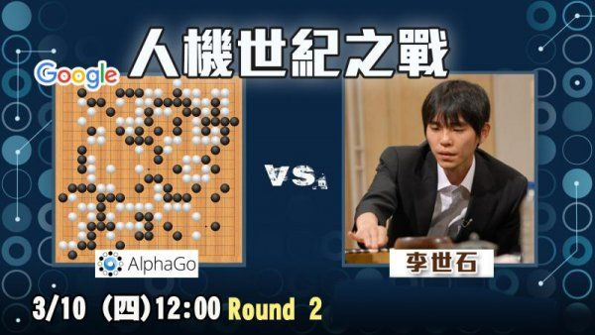
AI Timeline
Deep Learning Revolution (2010s)
2011
2012
2016
2018
IBM Watson wins Jeopardy!
AlexNet wins ImageNet
AlphaGo defeats Lee Sedol
BERT & GPT launched
Natural language understanding reaches a milestone.
Deep neural networks outperform traditional ML.
Reinforcement learning triumph.
Beginning of the transformer revolution.

Slide 8
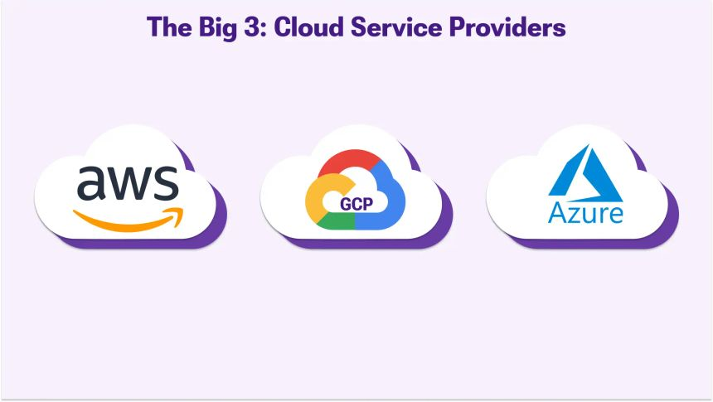

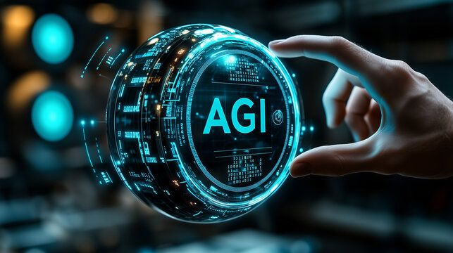
AI Timeline
Generative AI and Cloud Era (2020s)
2020
2022
2025
Cloud computing democratizes AI
ChatGPT launches
AI Ethics and AGI Research
AWS, Azure, and GCP power global models.
AI becomes conversational and accessible.
Focus shifts to safety, governance, and collaboration.

